Slide 1
Wine Quality
Group 10：
Team members: Yina Wei Jiayu Ni
Overview
Basic Data Analysis
Linear Regression
Neural Network
Random Forest
Summary and Comparison

Slide 2
Overview-methods
Analyze data
Set up models
Make prediction
Test our prediction

Slide 3
Methods
Linear Regression
One-layer Neural Network
Ensemble Neural Network
Random Forest

Slide 4
Data Analysis
Histogram
Correlation

Slide 5
Data
Resource
UC Irvine Machine Learning Repository:
http://archive.ics.uci.edu/ml/datasets/Wine+Quality
Original Data
Red wine + White wine

Slide 6
Data Details
Independent Variables:
Color
Fixed acidity
Volatile acidity
Citric acid
Residual sugar
Chlorides
Free sulfur dioxide
Total sulfur dioxide
Density
PH
Sulphates
Alcohol
Quality

Slide 7
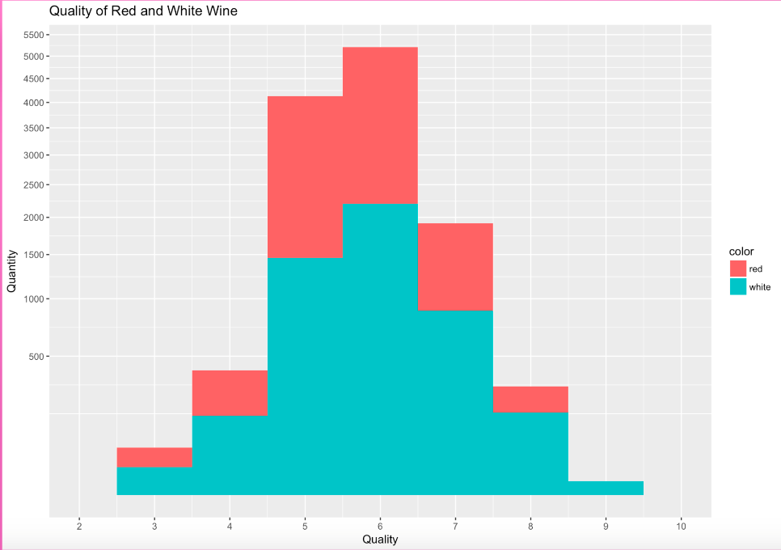
Histogram

Slide 8
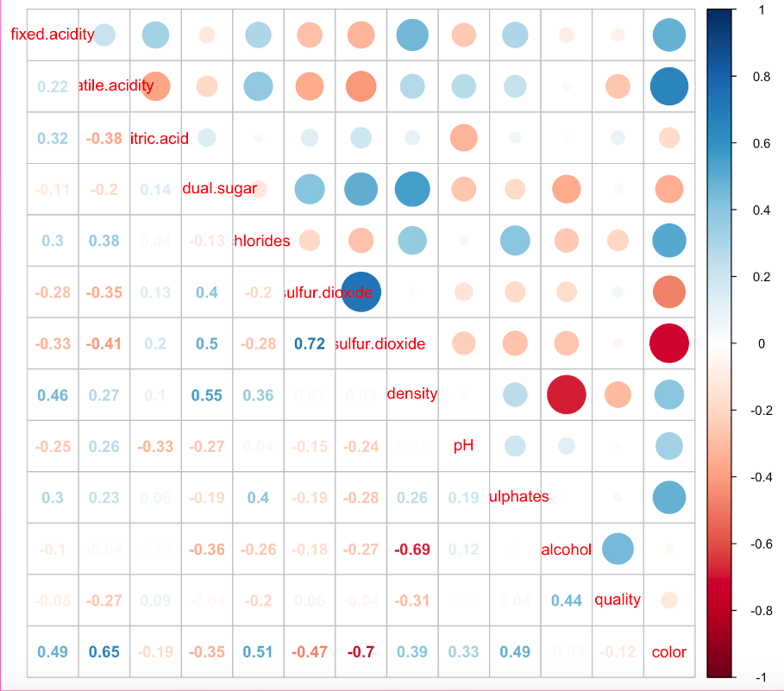
Correlation

Slide 9
Process Data
Scale Data
Divide Data:
training data
testing data

Slide 10
Linear Regression
LASSO
Cross Validation

Slide 11
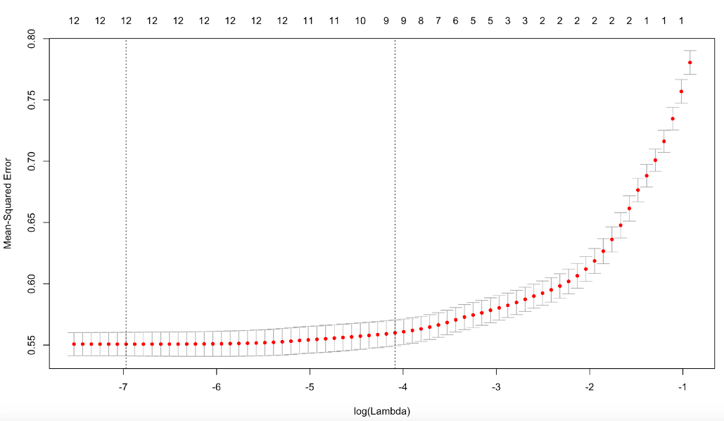
LASSO-–Find Lambda
MSE:
Minimized when log lambda is -6.9708
Chosen lambda:
0.0009388

Slide 12
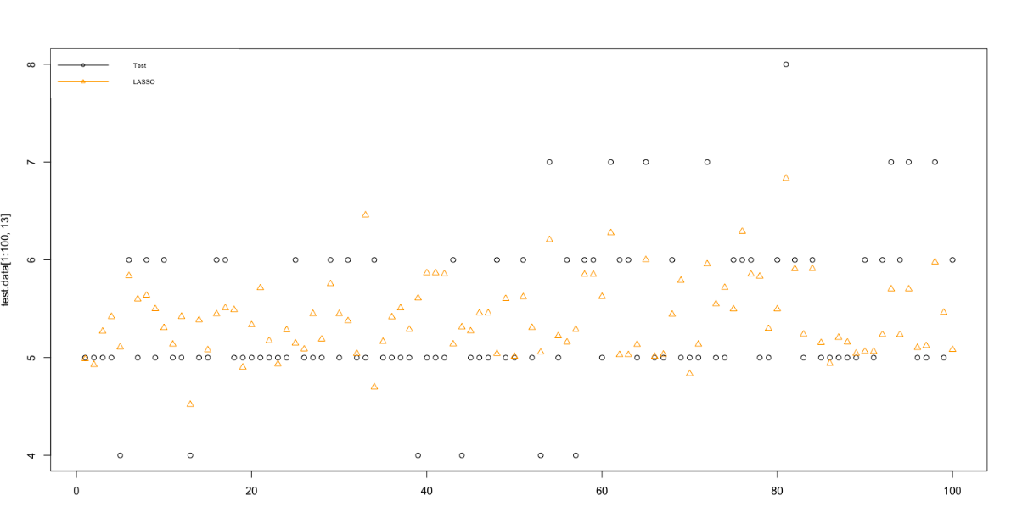
Result: linear Regression--MSE: 0.5201

Slide 13
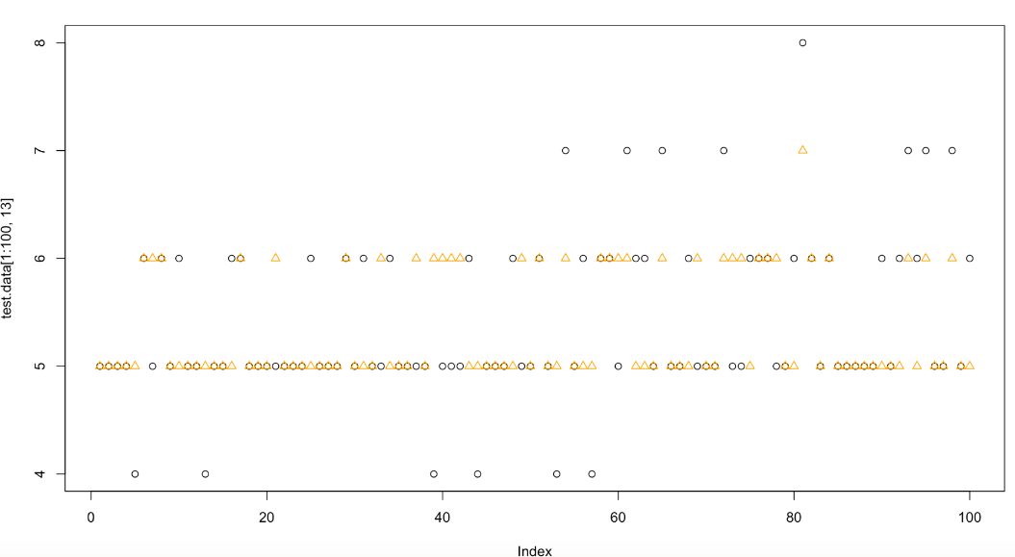
Result with rounding Linear Regression--MSE:0.55166

Slide 14
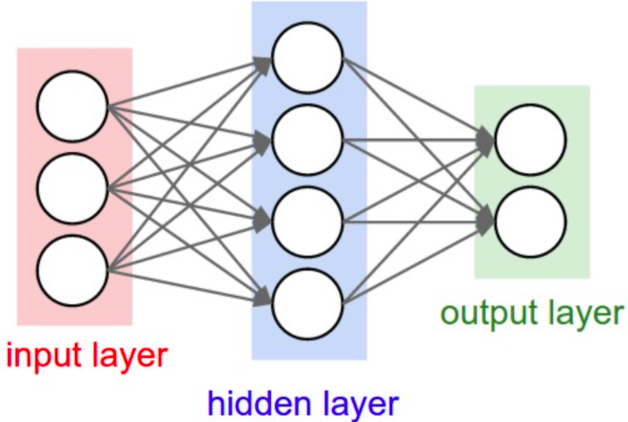
Neural Network

Slide 15
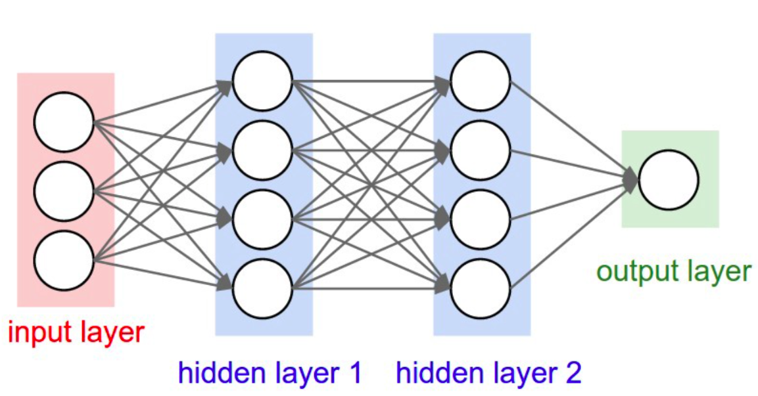
Two hidden layer

Slide 16
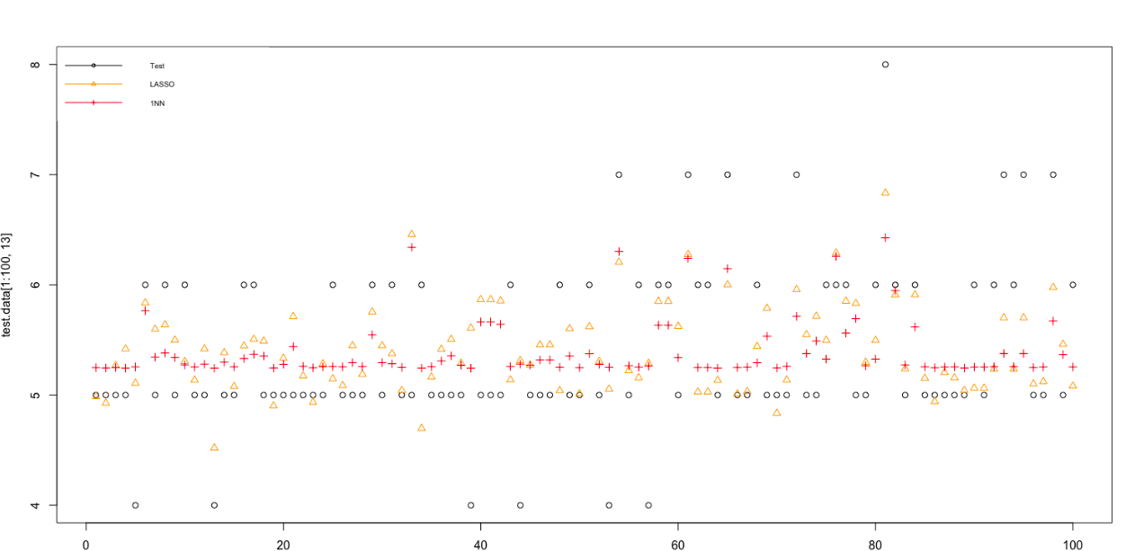
One layer neural network one layer, two neurons—MSE: 0.5384

Slide 17
Ensemble Neural Network
Ten Models:
One layer two neurons
One layer three neurons
Two layers with two neurons each
Two layers with three neurons each
Three layers with two neurons each
Three layers with three neurons each
Three layers with four neurons each
Four layers with two neurons each
Four layers with three neurons each
Four layers with Four neurons each
Each model ran five times

Slide 18
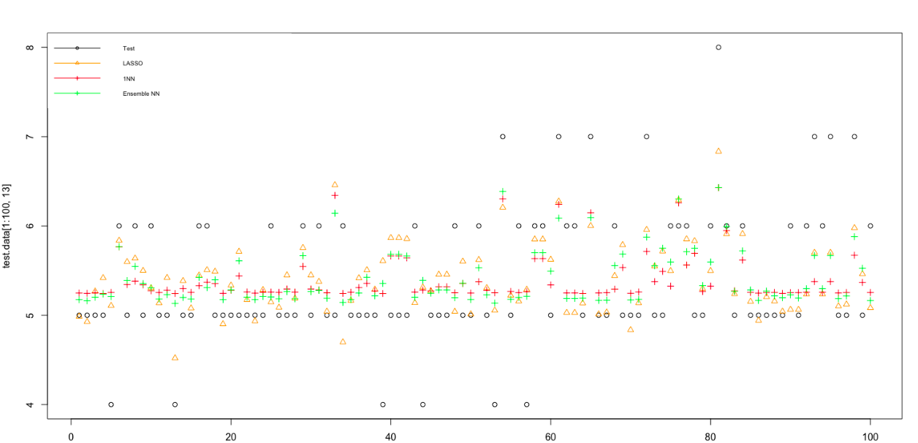
Ensemble Neural Network Up to four layer, four neurons each—MSE: 0.4973

Slide 19
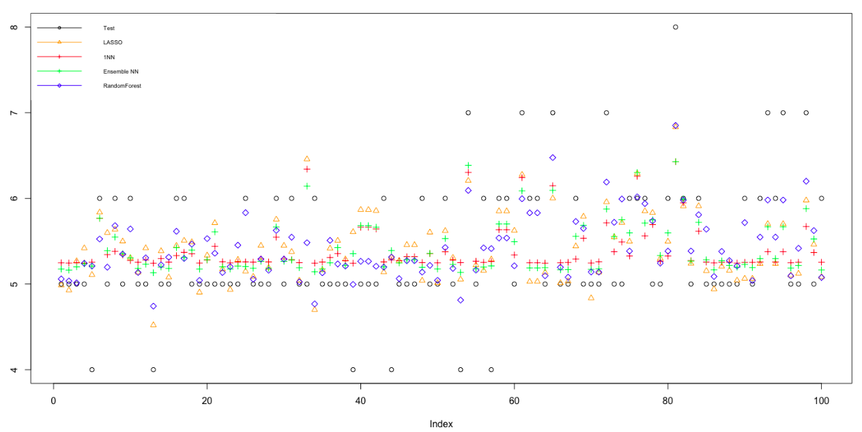
Random Forest MSE: 0.34

Slide 20
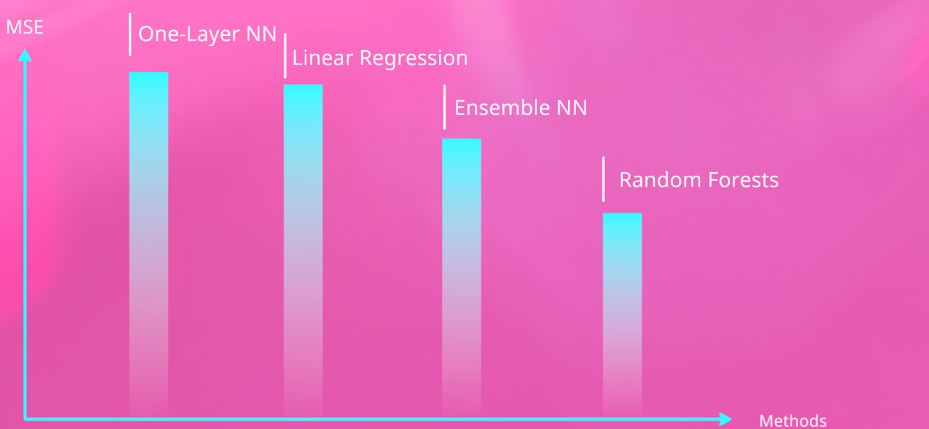
Comparison

